Slide 1
Intent
Decouple an abstraction from its implementation so that the two can vary independently
Allows different implementations of an interface to be decided upon dynamically.
Also known as Handle/Body pattern

Slide 2
Motivation & Applicability
Avoid a permanent binding between an abstraction and its implementation
Both the abstractions and their implementation should be extensible by subclassing
Changes in the implementation of an abstraction do not impact the clients
Share an implementation among multi objects and this facts should be hidden from the client
E.g.: Windows

Slide 3
Participants
Abstraction
Refined abstraction
Concrete implementor
Implementor

Slide 4
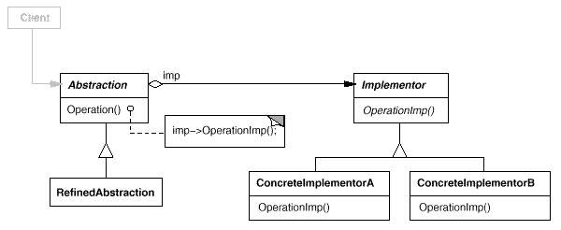
Structure

Slide 5
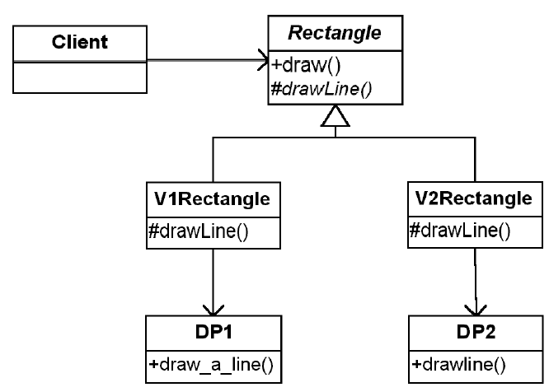
Example of problem suitable for bridge

Slide 6
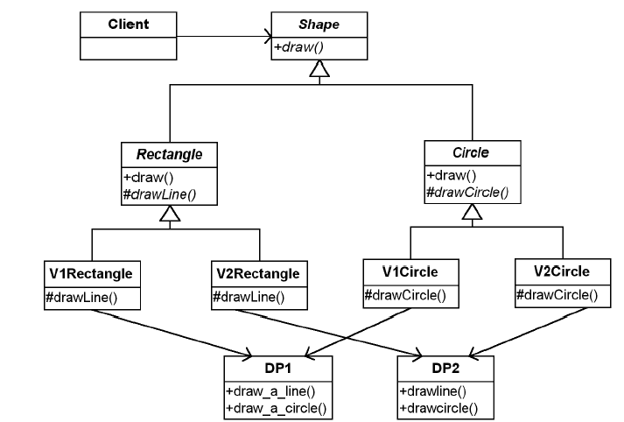
A more complex situation

Slide 7
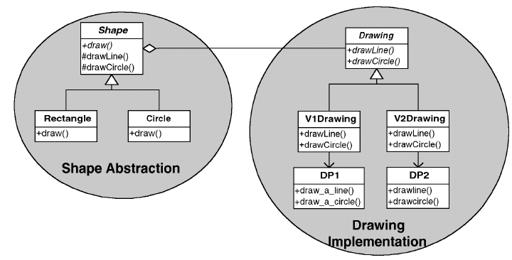
Solution using Bridge

Slide 8
Pros & Cons
Pros
decoupling of the implementation from the interface
improved extensibility of classes
additional capability for hiding implementation details from clients
best leveraged as a pure design-time pattern
Cons (Implementation Issues)
abstractions that have only one implementation
creating the right Implementor
sharing implementors
use of multiple inheritance

Slide 9
Decorator Pattern - Motivation
Widget Example
Suppose you have a user interface toolkit and you wish to make a border or scrolling feature available to clients without defining new subclasses of all existing classes.
The client "attaches" the border or scrolling responsibility to only those objects requiring these capabilities.
Widget* aWidget = new BorderDecorator( new ScrollDecorator(new TextView), 1); aWidget->draw();
Stream Example
cascading responsibilities on to an output stream
Stream* aStream = new CompressingStream( new ASCII7Stream( new FileStream( "fileName.dat" ))); aStream->putString( "Hello world" );

Slide 10
Decorator Pattern - Motivation
VisualComponent
draw()
TextView
Decorator
+component
draw()
draw()
component.draw()
ScrollDecorator
BorderDecorator
scrollPosition
borderWidth
draw()
draw()
super.draw()
scrollto()
drawBorder()
drawBorder()
Decorator subclasses are free to add operations for specific functionality. For example, ScrollDecorator's ScrollTo operation lets other objects scroll the interface if they know there happens to be a ScrollDecorator object in the interface.

Slide 11
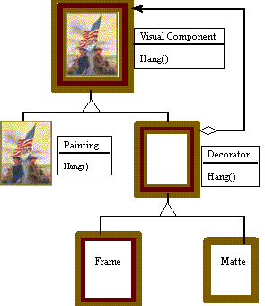
Decorator Pattern - Motivation
Painting Example
Although paintings can be hung on a wall with or without frames, frames are often added, and it is the frame which is actually hung on the wall.
Prior to hanging, the paintings may be matted and framed, with the painting, matting, and frame forming a single visual

Slide 12
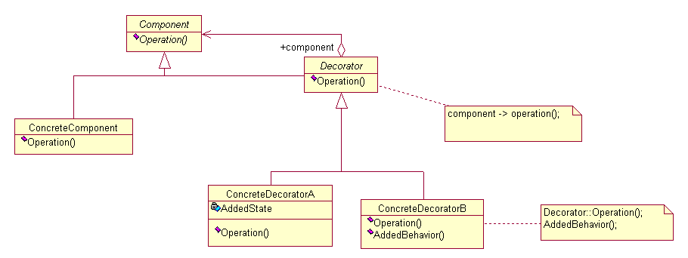
Decorator Pattern - Structure
Intent
Attach additional responsibilities to an object dynamically.
Decorators provide a flexible alternative to subclassing for extending functionality.
Structure
Structure

Slide 13
Introduction to C++ Templates
C++ Function Templates
C++ Class Templates

Slide 14
C++ Function Templates
Approaches for functions that implement identical tasks for different data types
Naïve Approach
Function Overloading
Function Template
Instantiating a Function Templates

Slide 15
Approach 1: Naïve Approach
create unique functions with unique names for each combination of data types
difficult to keeping track of multiple function names
lead to programming errors

Slide 16
Example
void PrintInt( int n )
{
cout << "***Debug" << endl;
cout << "Value is " << n << endl;
}
void PrintChar( char ch )
{
cout << "***Debug" << endl;
cout << "Value is " << ch << endl;
}
void PrintFloat( float x )
{
…
}
void PrintDouble( double d )
{
…
}
To output the traced values, we insert:
PrintInt(sum);
PrintChar(initial);
PrintFloat(angle);

Slide 17
Approach 2:Function Overloading (Review)
The use of the same name for different C++ functions, distinguished from each other by their parameter lists
Eliminates need to come up with many different names for identical tasks.
Reduces the chance of unexpected results caused by using the wrong function name.

Slide 18
Example of Function Overloading
void Print( int n )
{
cout << "***Debug" << endl;
cout << "Value is " << n << endl;
}
void Print( char ch )
{
cout << "***Debug" << endl;
cout << "Value is " << ch << endl;
}
void Print( float x )
{
}
To output the traced values, we insert:
Print(someInt);
Print(someChar);
Print(someFloat);

Slide 19
Approach 3: Function Template
A C++ language construct that allows the compiler to generate multiple versions of a function by allowing parameterized data types.
FunctionTemplate
Template < TemplateParamList >
FunctionDefinition
TemplateParamDeclaration: placeholder
class typeIdentifier
typename variableIdentifier
Notes:
For most people, the first and most obvious use of templates is to define and use container classes such as string, vector, list and map. Soon after, the need for template functions arises. Sorting an array is a simple example:
template <class T> void sort(vector<T> &);
void f(vector<int>& vi, vector<string>& vs)
{
sort(vi);
sort(vs);
}
template<class T> void sort(vector<T> &v)
{
const size_t n = v.size();
for (int gap=n/2; 0 < gap; gap /= 2)
for (int I = gap; I < n; i++)
for (j = I – gap; 0 <= j; j-=gap)
if (v[j+gap]<v[j]) {
T temp = v[j];
v[j] = v[i];
v[j+gap] = temp;
}
}

Slide 20
Example of a Function Template
template<class SomeType>
void Print( SomeType val )
{
cout << "***Debug" << endl;
cout << "Value is " << val << endl;
}
Template parameter
(class, user defined type, built-in types)
To output the traced values, we insert:
Template argument
Print<int>(sum);
Print<char>(initial);
Print<float>(angle);

Slide 21
Instantiating a Function Template
When the compiler instantiates a template, it substitutes the template argument for the template parameter throughout the function template.
TemplateFunction Call
Function < TemplateArgList > (FunctionArgList)

Slide 22
A more complex example
template<class T> void sort(vector<T>& v)
{
const size_t n = v.size();
for (int gap=n/2; 0<gap; gap/=2)
for (int i=gap; i<n; i++)
for (int j=i-gap; 0<j; j-=gap)
if (v[j+gap]<v[j]) {
T temp = v[j];
v[j] = v[j+gap];
v[j+gap] = temp;
}
}
Notes:
Shell sort

Slide 23
Summary of Three Approaches
Naïve Approach
Different Function Definitions
Different Function Names
Function Overloading
Different Function Definitions
Same Function Name
Template Functions
One Function Definition (a function template)
Compiler Generates Individual Functions

Slide 24
Class Template
A C++ language construct that allows the compiler to generate multiple versions of a class by allowing parameterized data types.
Class Template
Template < TemplateParamList >
ClassDefinition
TemplateParamDeclaration: placeholder
class typeIdentifier
typename variableIdentifier

Slide 25
Example of a Class Template
template<class ItemType>
class GList
{
public:
bool IsEmpty() const;
bool IsFull() const;
int Length() const;
void Insert( /* in */ ItemType item );
void Delete( /* in */ ItemType item );
bool IsPresent( /* in */ ItemType item ) const;
void SelSort();
void Print() const;
GList(); // Constructor
private:
int length;
ItemType data[MAX_LENGTH];
};
Template parameter
Notes:
Template <class ItemType> says that ItemType is a type name, it need not be the name of a class.
The scope of ItemType extends to the end of the declaration prefixed by template <class ItemType>

Slide 26
Instantiating a Class Template
Class template arguments must be explicit.
The compiler generates distinct class types called template classes or generated classes.
When instantiating a template, a compiler substitutes the template argument for the template parameter throughout the class template.
Notes:
The process of generating a class declaration from a template class and a template argument is often called template instantiation. Similarly, a function is generated (“instantiated”) from a template function plus a template argument. A version of a template for a particular template argument is called a specialization.

Slide 27
Instantiating a Class Template
To create lists of different data types
// Client code
GList<int> list1;
GList<float> list2;
GList<string> list3;
list1.Insert(356);
list2.Insert(84.375);
list3.Insert("Muffler bolt");
template argument
Compiler generates 3 distinct class types
GList_int list1;
GList_float list2;
GList_string list3;
Notes:
The name of a class template followed by a type bracketed by <> is the name of a class (as defined by the template) and can be used exactly like other class names.

Slide 28
Substitution Example
class GList_int
{
public:
void Insert( /* in */ ItemType item );
void Delete( /* in */ ItemType item );
bool IsPresent( /* in */ ItemType item ) const;
private:
int length;
ItemType data[MAX_LENGTH];
};
int
int
int
int

Slide 29
Function Definitions for Members of a Template Class
template<class ItemType>
void GList<ItemType>::Insert( /* in */ ItemType item )
{
data[length] = item;
length++;
}
//after substitution of float
void GList<float>::Insert( /* in */ float item )
{
data[length] = item;
length++;
}

Slide 30
Another Template Example: passing two parameters
template <class T, int size>
class Stack {...
T buf[size];
};
Stack<int,128> mystack;
non-type parameter
Notes:
A template can take type parameters, parameters of ordinary types such as ints, and template parameters.
For example, simple and constrained containers such as Stack or Buffer can be important where run-time efficiency and compactness are paramount. Passing a size as a template argument allows Stack’s implementer to avoid free store use.
An integer template argument must be constant

Slide 31
Take Home Message
Templates are mechanisms for generating functions and classes on type parameters. We can design a single class or function that operates on data of many types
function templates
class templates

Slide 32
Introduction to C++ STL

Slide 33
Standard Template Library
In the late 70s Alexander Stepanov first observed that some algorithms do not depend on some particular implementation of a data structure but only on a few fundamental semantic properties of the structure
Developed by Stepanov and Lee at HP labs in 1992
Become part of the C++ Standard in 1994
Notes:
STL, is a C++ library of container classes, algorithms, and iterators; it provides many of the basic algorithms and data structures of computer science. The STL is a generic library, meaning that its components are heavily parameterized: almost every component in the STL is a template.

Slide 34
STL – Standard Template Library
Collections of useful classes for common data structures
Ability to store objects of any type (template)
Study of containers
Containers form the basis for treatment of data structures
Container – class that stores a collection of data
STL consists of 10 container classes:
Sequence containers
Adapter containers
Associative containers

Slide 35
STL Containers
Sequence Container
Stores data by position in linear order:
First element, second element , etc:
Associate Container
Stores elements by key, such as name, social security number or part number
Access an element by its key which may bear no relationship to the location of the element in the container
Adapter Container
Contains another container as its underlying storage structure

Slide 36
STL Containers
Sequence Container
Vector
Deque
List
Adapter Containers
Stack
Queue
Priority queue
Associative Container
Set, multiset
Map, multimap

Slide 37
Vector Container
Generalized array that stores a collection of elements of the same data type
Vector – similar to an array
Vectors allow access to its elements by using an index in the range from 0 to n-1 where n is the size of the vector
Vector vs array
Vector has operations that allow the collection to grow and contract dynamically at the rear of the sequence

Slide 38
Vector Container
Example:
#include <vector>
.
.
.
vector<int> scores (100); //100 integer scores
vector<Passenger>passengerList(20); //list of 20 passengers

Slide 39
Vector Container
Allows direct access to the elements via an index operator
Indices for the vector elements are in the range from 0 to size() -1
Example:
#include <vector>
vector <int> v(20);
v[5]=15;

Slide 40
List Container
Stores elements by position
Each item in the list has both a value and a memory address (pointer) that identifies the next item in the sequence
To access a specific data value in the list, one must start at the first position (front) and follow the pointers from element to element until data item is located.
List is not a direct access structure
Advantage: ability to add and remove items efficiently at any position in the sequence

Slide 41
Stack Container
Adapter Container
These containers restrict how elements enter and leave a sequence
Stack
allows access at only one end of the sequence (top)
Adds objects to container by pushing the object onto the stack
Removes objects from container by popping the stack
LIFO ordering (last end, first out)

Slide 42
Queue Container
Queue
Allows access only at the front and rear of the sequence
Items enter at the rear and exit from the front
Example: waiting line at a grocery store
FIFO ordering (first-in first-out )
push(add object to a queue)
pop (remove object from queue)

Slide 43
Priority Queue Container
Priority queue
Operations are similar to those of a stack or queue
Elements can enter the priority queue in any order
Once in the container, a delete operation removes the largest (or smallest) value
Example: a filtering system that takes in elements and then releases them in priority order 8
18 13
3 15
27

Slide 44
Set Container
Set
Collection of unique values, called keys or set members
Contains operations that allow a programmer to:
determine whether an item is a member of the set
insert and delete items very efficiently
Set A
Set B
1 3
27 15
Buick Ford
Jeep BMW

Slide 45
Multi-Set Container
A multi-set is similar to a set, but the same value can be in the set more than once
Multi-set container allows duplicates

Slide 46
Map Container
Implements a key-value relationship
Programmer can use a key to access corresponding values
Example: key could be a part number such as A24-57 that corresponds to a part: 8.75 price and Martin manufacturer
A22-56
A23-57
A24-57
A24-57 | 8.75 | Martin
A22-56 | 12.50 | Calloway
A23-57 | 4.95 | Mirage

Slide 47
Multi-map Container
Similar to a map container
Multi-map container allows duplicates

Slide 48
How to access Components - Iterator
Iterator is an object that can access a collection of like objects one object at a time.
An iterator can traverse the collection of objects.
Each container class in STL has a corresponding iterator that functions appropriately for the container
For example: an iterator in a vector class allows random access
An iterator in a list class would not allow random access (list requires sequential access)

Slide 49
Common Iterator Operations
* Return the item that the iterator currently references
++ Move the iterator to the next item in the list
-- Move the iterator to the previous item in the list
== Compare two iterators for equality
!= Compare two iterators for inequality

Slide 50
STL List Class
Constructors and assignment
list <T> v;
list<T> v(aList);
l=aList;
Access
l.front() ----returns 1st element in the list
l.back()----returns the last element in the list

Slide 51
STL List
Insert and Remove
l.push_front(value)
l.push_back(value)
Iterator Delaration
list<T>::iterator itr;
Iterator Options
itr = l.begin() set iterator to beginning of the list
Itr = l.end() set iterator to after the end of the list

Slide 52
Writing classes that work with the STL
Classes that will be stored in STL containers should explicitly define the following:
Default constructor
Copy constructor
Destructor
operator =
operator==
operator<
Not all of these are always necessary, but it might be easier to define them than to figure out which ones you actually need
Many STL programming errors can be traced to omitting or improperly defining these methods

